Slide 1
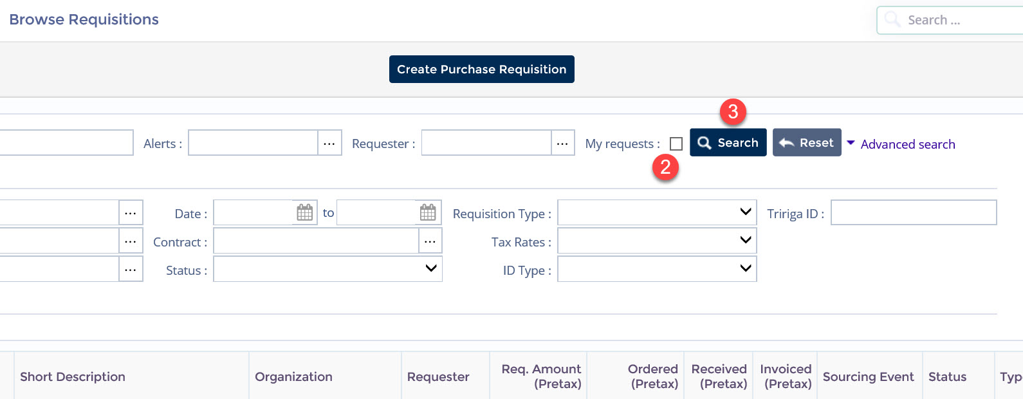
Viewing Requisitions
This document is a quick-reference guide for Agency Administrators to view and search all requisitions within their respective agency in the Arizona Procurement Portal (APP.) If you have any questions, please contact the APP Help Desk at 602-542-7600 or email app@azdoa.gov. Additional resources are also available on the SPO Website: https://spo.az.gov/.
Viewing All Agency-Specific Requisitions
From any page in APP, navigate to the Procurement drop-down menu and select Browse Requisitions. You will see a list of requisitions that ONLY you have initiated.
Click the My requests checkbox to remove the check.
Click the Search button. Results listed will include ALL requisitions initiated within your respective agency.
Please note: This is a short-term workaround. A fix will be implemented in a future release.

